Slide 1

Final presentation Customer satisfaction project.
Alaa Ahmed Abdel Naeem Ahmed
Group: NEXT78_GIZ1_ERP8_M1e

Slide 2

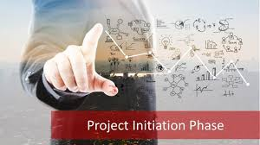
Table of content:
Initiation phase :
Situation Statement.
SWOT Analysis of the company.
Fish Bone Analysis
SMART Goals
OKRS
Stakeholders Matrix
Stakeholders Power Grid
RACI Chart
Project Charter
Planning phase :
WBS
PDM
Gantt chart (schedule)
Budget
SOW
Risk management plan
Communication plan
Project plan

Slide 3

Initiation phase

Slide 4


Situation Statement:
Problem at Hendawy Petroleum service company
A customer has expressed dissatisfaction with the way an employee spoke to them during a recent interaction, as well as concerns regarding the quality and quantity of the product they received.
The customer feels disrespected by the employee's tone and attitude, which has compounded their frustration with the product not meeting expectations.
Effect on the Customer
Customer feel frustrated and disrespected.
The combination of poor service and subpar product quality can lead to a significant decline in customer loyalty.
A dissatisfied customer is likely to share their negative experience with others, either through personal conversations or online reviews.
Feeling disrespected by an employee's tone can cause the customer to experience emotional distress, leading to a deeper sense of dissatisfaction.
Situation statement on drive

Slide 5
Situation Statement:
Impact on the Business
Negative feedback harming the company’s reputation.
As dissatisfied customers lead to continues losing, negative impacting on sales.
If this issue becomes widespread or publicly known within the company, it could lead to decreased morale among employees. They might feel undervalued or unsupported, which can further degrade the quality of service they provide.
Resolving such issues often requires offering refunds, discounts, or other compensations to the affected customer. Furthermore, the business may need to invest in additional training for employees to prevent similar situations, increasing operational costs.
In extreme cases, a customer who feels significantly wronged might seek legal action, especially if they believe there is a pattern of disrespect or discrimination. This can lead to costly legal battles and further damage to the company's image.
In a competitive market, poor customer service and product quality can erode the business’s competitive edge, leading to a decline in its overall market position.
Situation statement on drive

Slide 6
SWOT Analysis of the company :
S
Exclusive Franchise Partnerships.
W
Limited Cash Availability.
T
O
Potential for Market Expansion.
Diverse Supplier Network.
High Dependence on Franchise Relationships.
Competition from Asian Franchises
Growing Market Demand in Angola.
Economic Instability
SWOT Analysis

Slide 7
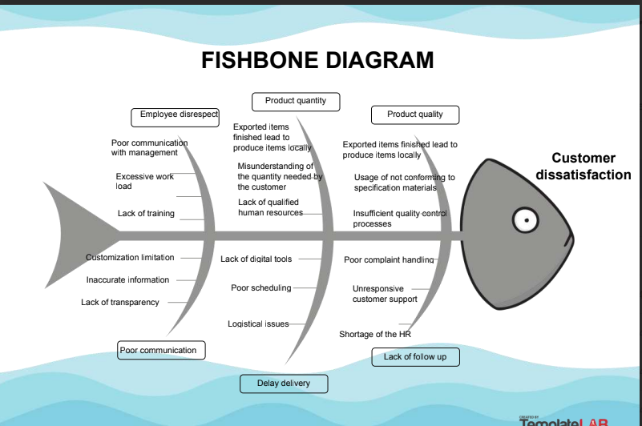
Fish bone analysis:
Fish Bone Analysis

Slide 8
SMART Goals:
Decrease the need for locally produced products through effective understanding of industry standards by hiring a specialist
Reduce delays in delivering products to customers by 80% within 6 months.
Apply a quality control system to meet European specifications within 3 years.
Provide communication training to customer-facing staff within 6 months.
Reduce workload by hiring new team members within 3 months.
Offer additional non-financial benefits to increase employee satisfaction and retention within 1 year.
Maximize Angola project potential within 6 months and expand into other African countries within 2 years.
SMART Goals

Slide 9
SMART Goals:
8. Collaborate with competitors in Saudi Arabia within the next Year.
9. Strengthen partnership with MAKEE company within 1 year for global expansion.
10. Implement an ERP system to improve communication and reduce bottlenecks by 60% within 9 months.
11. Improve customer satisfaction by 20% within 6 months through better service.
12. Improve communication skills among executives and managers within 3 months.
SMART Goals

Slide 10
OKRS:
Enhance product quality to compete internationally.
Employee empowerment, engagement, satisfaction to be able to compete globally.
Monopoly the market in the Africa and the middle east.
Two-way communication for organization to feel like a family .
OKRS

Slide 11
Stakeholders Matrix:
Stakeholder | Role Related to Project | Involvement | Impact on Project | Power of Influence | Interest | Engagement Strategy
CEO | - Project sponsor Provides funding and executive support. | Make high level decisions, serves as team resource and approves project goals. | Wants the project to succeed, no resistance. | High | Medium | Regular updates but not on a daily manner, strategic discussions through asking questions& give updates.
Project team members | Project execution team | Manages day-to-day operations, knowledge of the project processes. | Invested in the project as a team member, possible resistance if their roles in organization affected. | High | High | Daily check-ins, progress tracking
Clients | Existing clients | Can give feedback on customer experience. | Some interested & other not, possible resistance only if negatively impacted. | Medium | Medium | Communicate as needed to inform & get feedback.
Departments Head | other department member not included in the project | Aligns operational needs with project | Ensures department's needs are met | Medium | High | Weekly status meetings, issue escalation
Finance Team | Financial project member | Tracks project spending and budget allocation | Manages budget and financial tracking | Medium | Medium | Monthly budget reports, risk analysis updates
Stakeholders matrix

Slide 12
Stakeholders Matrix:
Stakeholder | Role Related to Project | Involvement | Impact on Project | Power of Influence | Interest | Engagement Strategy
IT Department | IT project member | Ensures system functionality and integration | Support and integrate all system of the company | High | Medium | Project requirement reviews, ongoing support
HR Department | Coordinator project member | Manages communication and training | Supports change management | Low | High | Workshops, communication plans, legal contract
End Users | (Employees) User of the project | Affected by the solution and its processes | Utilize the solution provided | Low | High | Feedback sessions, user acceptance testing (UAT)
Legal Team | Lawyer and regulation project member | Reviews contracts and ensures legal compliance | Ensures compliance with regulations | Low | Medium | Risk and compliance check-ins
Procurement Team | Purchasing material project member | Ensures materials and services are provided | Handles vendor contracts and supplies | Medium | Low | Procurement process alignment, vendor management
External Vendors | Third party vendors | Deliver services according to contracts | Provide necessary products/services | Low | Low | Regular performance reviews, contract management
Governmental agencies | All government agencies dealing with the project | Set the boundaries and standards for specific project processes | May continue or stop the project | High | Medium | Project process specification
Stakeholders matrix

Slide 13
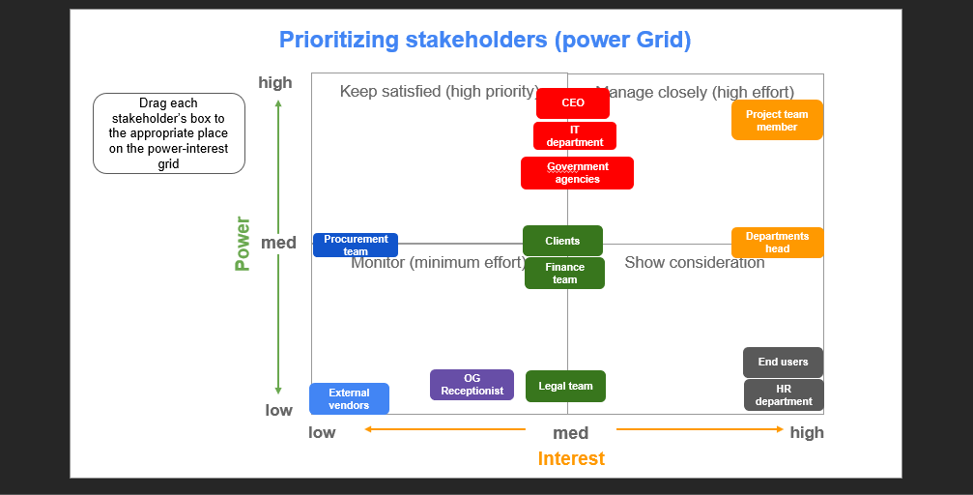
Stakeholders Power Grid:
Stakeholders power grid

Slide 14
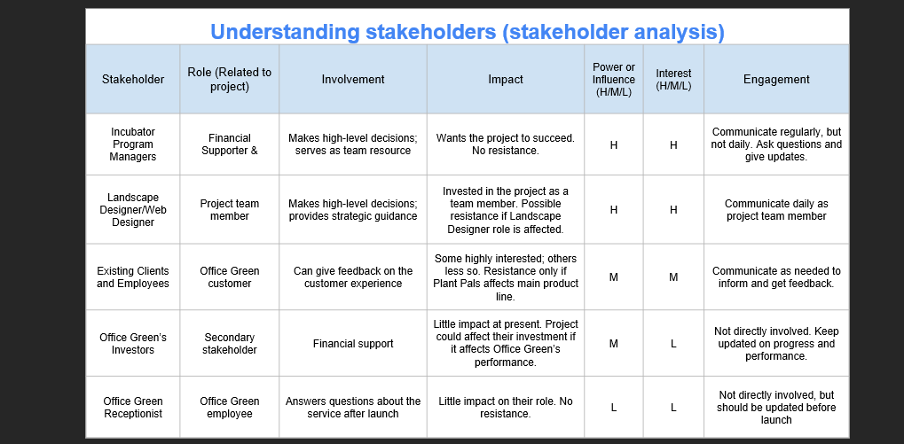
Stakeholders Power Grid:
Stakeholders power grid

Slide 15
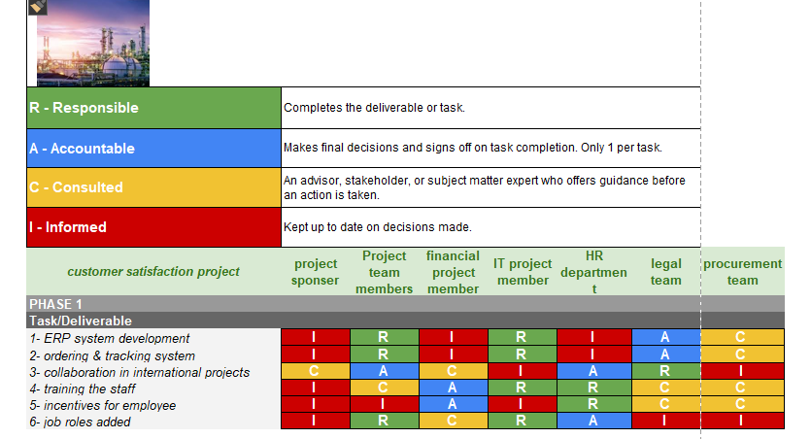
RACI Chart:
RACI chart

Slide 16
Project Charter:
Project Goal
SMART: Specific, Measurable, Attainable, Relevant, Time-bound Enhance product quality by 90% within 6 months through implementing comprehensive tracking system. Employee empowerment, engagement, satisfaction increase by 50% within 3 months through increase effectiveness of the tasks by 50% through the same period. Monopoly the market in Africa specially in Angola in the next 6 months and overall Africa within 2 years through leverage the franchise partnership of Makkee company and middle east in the upcoming year through asking for collaboration with Saudi Arabia for mutual monetary benefits through increasing the revenue by 30 % resulting from this collaboration. Apply ERP system to achieve 2-way communication through reporting system merge the company levels and resolve the bottlenecks by 60% within the next 6 months.
PROJECT CHARTER

Slide 17
Project Charter:
Deliverables:
● Apply comprehensive quality control system . ● Apply comprehensive tracking system. ● Apply ERP system include reporting system. ● Provide training program to current and potential employee . ● Implement marketing campaign.
PROJECT CHARTER

Slide 18
Project Charter:
Business Case / Background
Why are we doing this? The Operations and Training plan will help us meet customer satisfaction and loyalty. The tracking system will help curb customer attrition. The quality control system provides a high-quality customer experience. By ensuring that the ERP system efficient launch, the Operations and Training plan will help us reach our larger project goal of a 30% revenue increase for Hendawy petroleum service company.
PROJECT CHARTER

Slide 19
Project Charter:
Benefits & Costs
Benefits Maintaining high quality standards following the initial service launch. Mitigation of potential revenue losses through customer attrition Increased customer satisfaction. Increase employee engagement, empowerment, satisfaction. Enhance product quality. Monopoly the market. Costs: Fulfilment and inventory maintenance costs. Cost of materials (including delivery trucks, packaging materials, etc.). Operational costs (ordering systems, transaction costs, overhead). Time spent on operational systems education and training for employees. Cost of international campaign, and public relation department. Budget needed: $350,000
PROJECT CHARTER

Slide 20
Project Charter:
Scope and Exclusion
In-Scope: Budget Management, Inventory Management, Software Maintenance, Supply Chain Fulfilment, Quality Controls, Transaction Methods, Human Resources Out-of-Scope: Web Development, Pricing, Account Management
Project Team
Project Sponsor: Director of Operations Project Lead: Project Manager Project Team: Fulfilment Director, Quality Assurance Tester, Inventory Manager, Budget Coordinator, Financial Analyst, Human Resource Specialist, Business analyst. Additional Stakeholders: VP of Customer Satisfaction, Account Manager, Receptionist, Sales Director, Sales Team, Marketing Director, Investors
PROJECT CHARTER

Slide 21
Project Charter:
Measuring Success:
What is acceptable: 95% of orders on time within the first 3 month of launch. 100% of orders packaged and ready for shipment within two days of being placed. Train at least 90% of employees before the official service launch. 30% revenue increase for Hendawy petroleum service company.
PROJECT CHARTER

Slide 22
planning phase

Slide 23
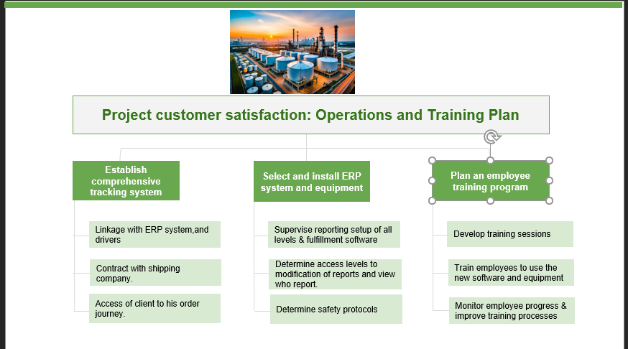
WBS:
WBS

Slide 24
PDM:
I | Task | Duration (days) | Dependencies
1 | Linkage with ERP system, and drivers | 10 days | None
2 | Contract with shipping company | 15 days | None
3 | Access of client to his order journey | 8 days | 1
4 | Supervise reporting setup of all levels & fulfillment software | 12 days | 1
5 | Determine access levels to modification of reports and view who reports | 5 days | 4
6 | Determine safety protocols | 7 days | 2
7 | Develop training sessions | 10 days | 5,6
8 | Train employees to use the new software and equipment | 10 days | 7
9 | Monitor employee progress & improve training processes | 5 days | 8
PDM

Slide 25
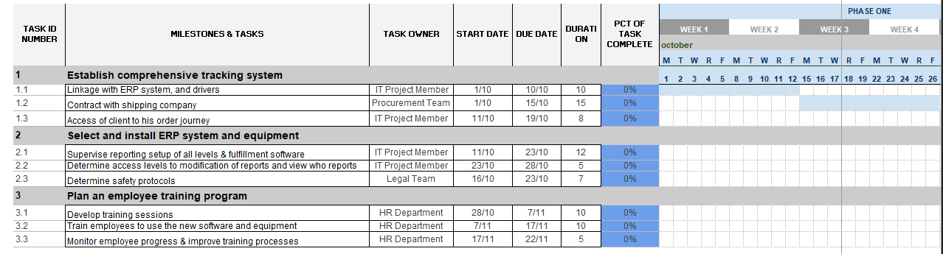
Gantt chart (schedule):
Gantt chart (schedule)

Slide 26
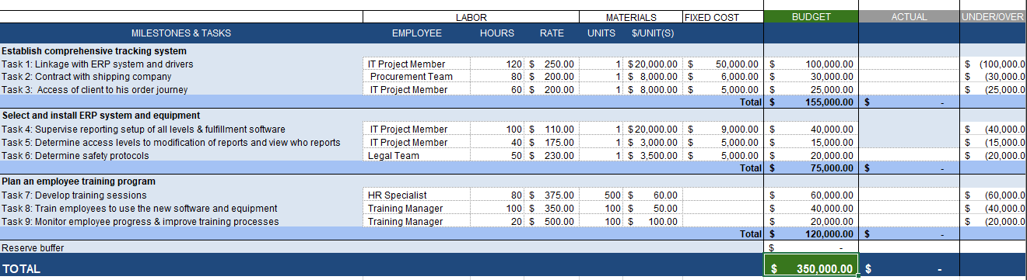
Budget:
Budget

Slide 27
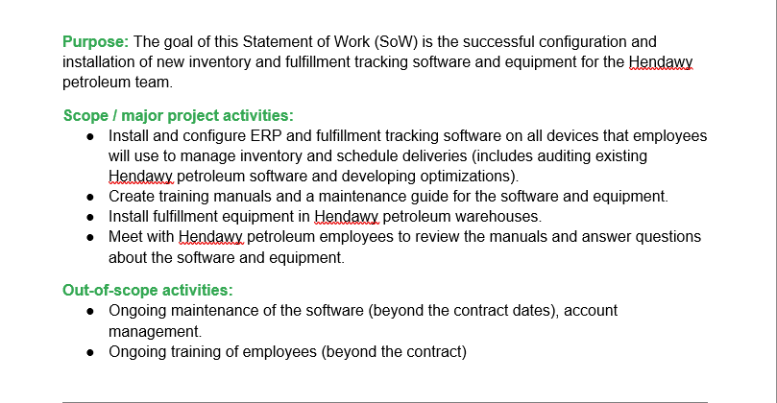
SOW:
SOW

Slide 28
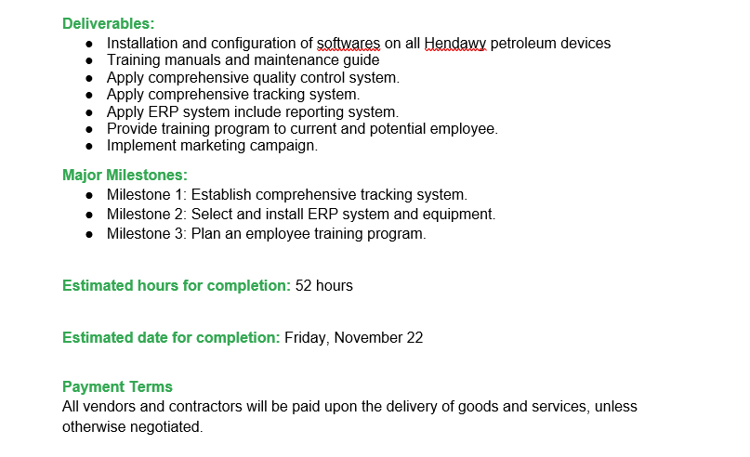
SOW:
SOW

Slide 29
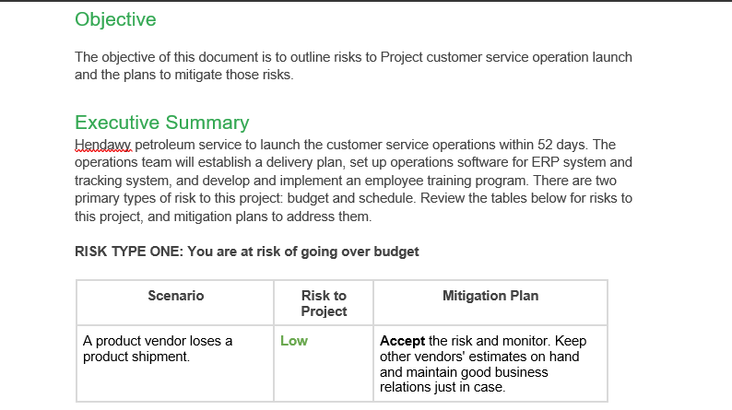
Risk management plan:
RMP

Slide 30
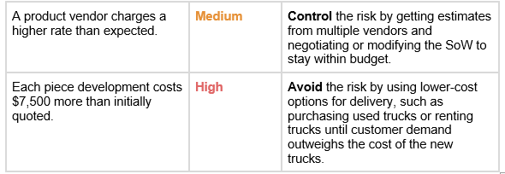
Risk management plan:
RMP

Slide 31
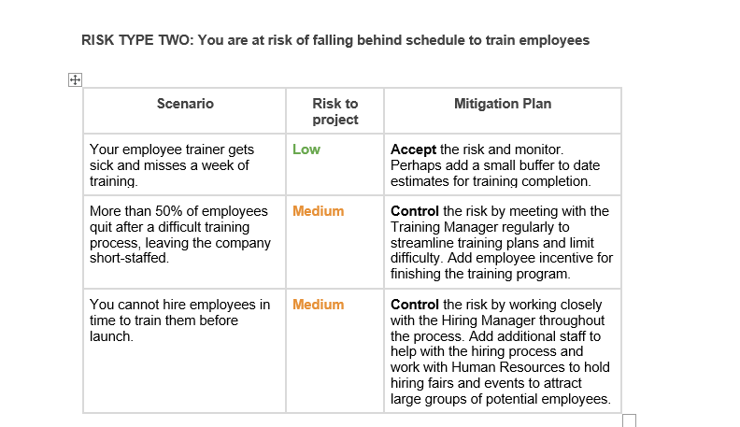
Risk management plan:
RMP

Slide 32
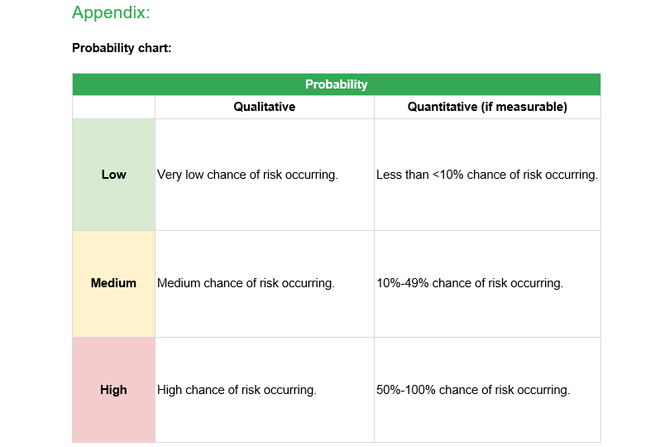
Risk management plan:
RMP

Slide 33
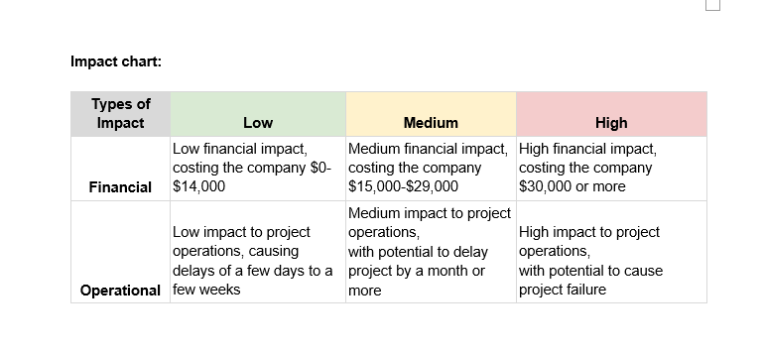
Risk management plan:
RMP

Slide 34
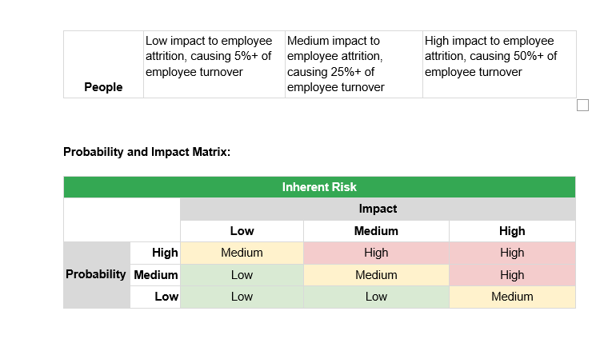
Risk management plan:
RMP

Slide 35
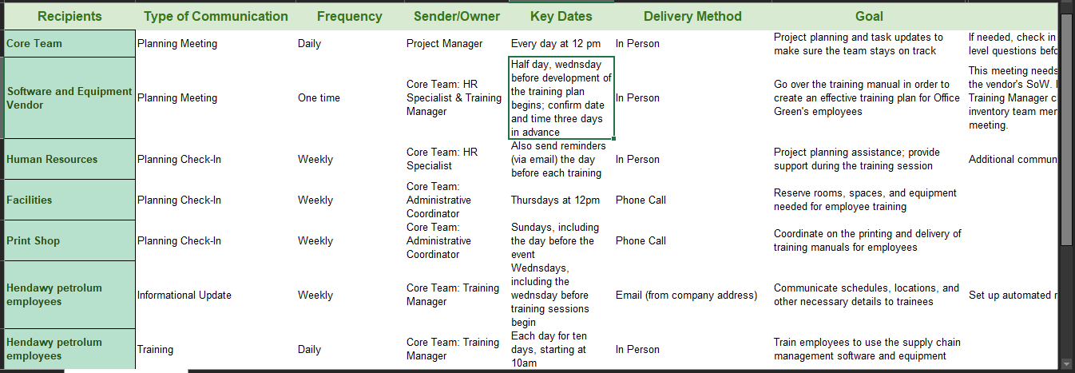
Communication plan :
Communication plan

Slide 36
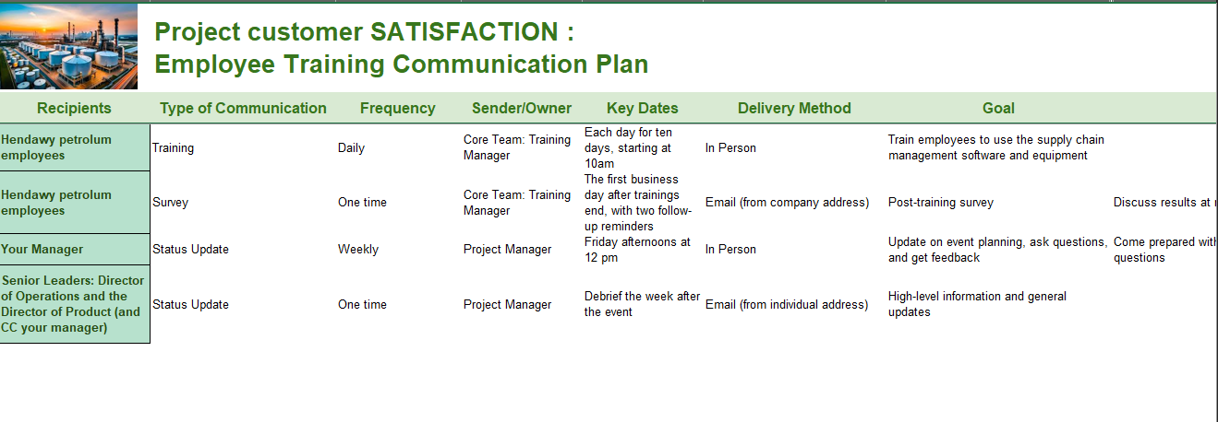
Communication plan :
Communication plan

Slide 37
Project plan

